Slide 1
Lab3 : a LSTM Cell for Image Captioning
Department of Computer Science, NCTU
TA Gabriel(陳璽存)

Slide 2
Important Rules
Important Date :
Report Submission Deadline: 12/01 (Wed) 11:59 AM
Demo date: 12/01 (Wed)
Turn in :
Experiment Report (.pdf)
Source code (.py)
Notice: zip all files in one file and name it like「DLP_LAB3_your ID_name.zip」, ex: 「DLP_LAB3_0756172_陳璽存.zip」

Slide 3
Important Rules
Email To :
sicun.mapl.cs09@nycu.edu.tw
Don’t CC other TA
Email Tilte :
DLP_LAB3_yourID_name
Do not submmit your weight or dataset!!
But you should save the model weight for demo

Slide 4
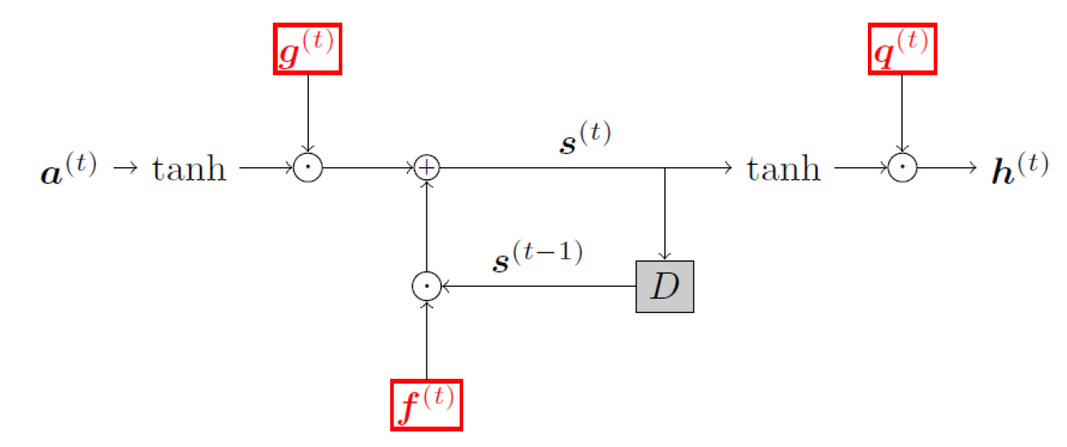
Lab Objective
In this lab, you only have to implement a LSTM cell by yourselves
Only DIY_LSTM.py
And train an image caption model with your own LSTM cell

Slide 5
Lab Requierment
Implement a LSTM cell
Please finish
Only Forward part , don’t worried
Replace the LSTM cell in Pytorch image-caption example with the one you implement.
Train an image caption model

Slide 6
Lab Resource & Instruction
Clone https://github.com/202-DL-Training-Program/Lab3-Image-Caption.git
Already on the sever
Please follow the Usage in Readme if you want to try on you own machine
Get the data
Already on the sever
Implement a LSTM cell (DIY_LSTM.py)
Train the model
You only need to start at “3. Preprocessing” in the Readme

Slide 7
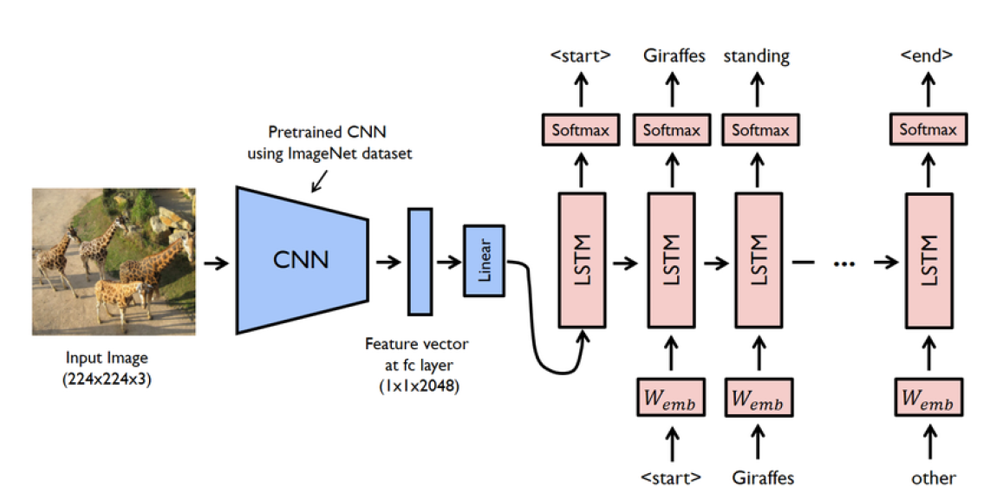
Image-Caption

Slide 8
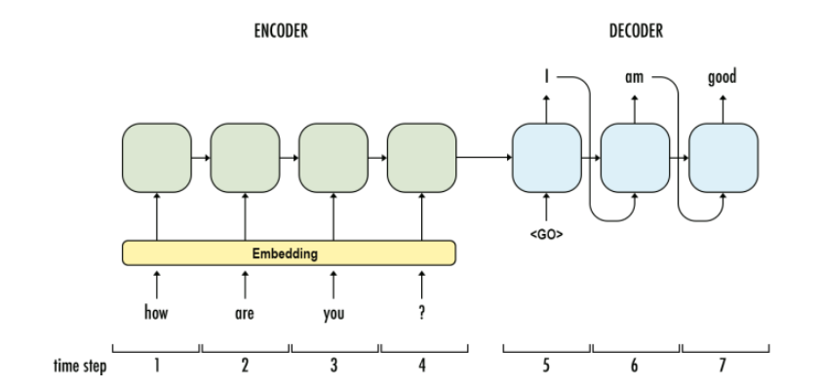
Encoder-Decoder

Slide 9
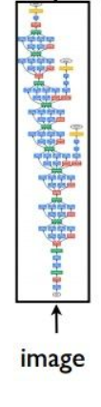
Encoder-Decoder
Show and Tell: A Neural Image Caption Generator

Slide 10
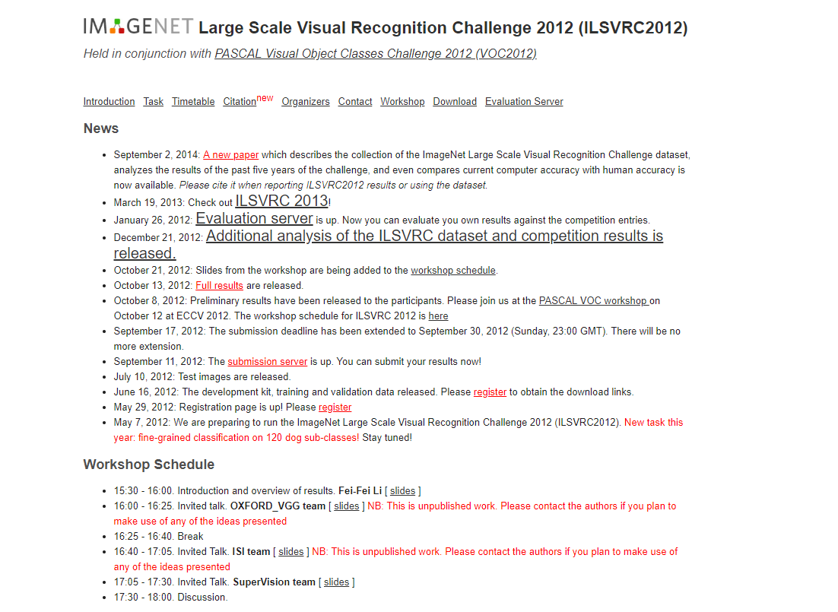
Dataset
ImageNet : Large Scale Visual Recognition Challenge 2012 (ILSVRC2012)
Very good dataset for
Classfication
localization
…..
Dataset for this lab
Image
Annotation

Slide 11
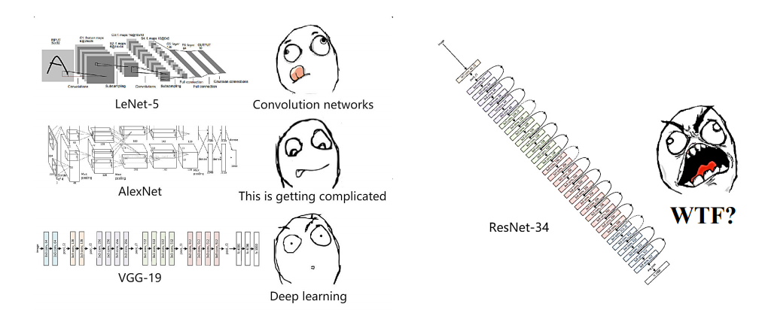

Encoder
Using pretrain models to extract feature vector from a given input image
Using pretrained ResNet-152
From Torchvision
ResNet-152

Slide 12
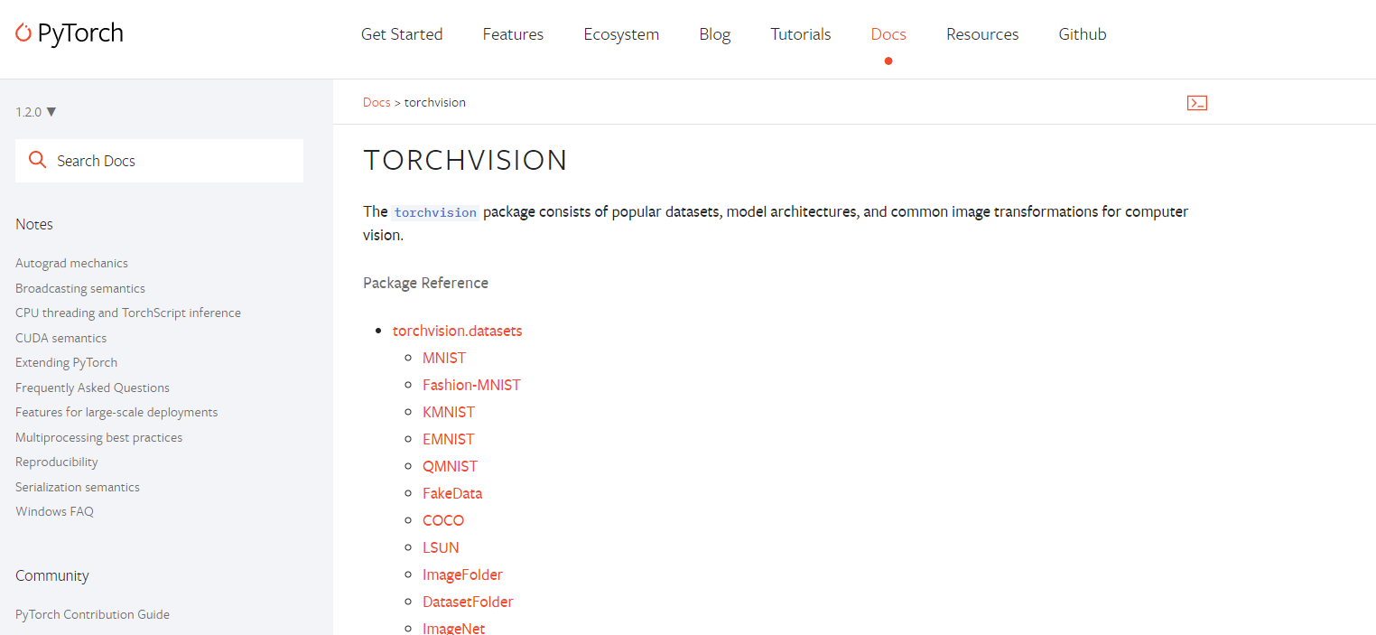
Torchvision
Pytorch official package consists of
popular datasets
model architectures
common image transformations for computer vision.

Slide 13


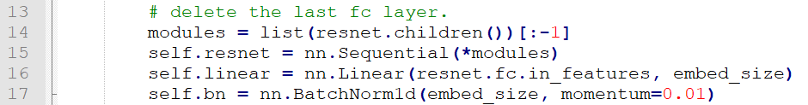
Pretrained ResNet-152
Pretrained on the ILSVRC-2012-CLS
Delete the last fc layer, use NEW linear layer to transform feature vector to have the same dimension as the input dimension of the LSTM network

Slide 14
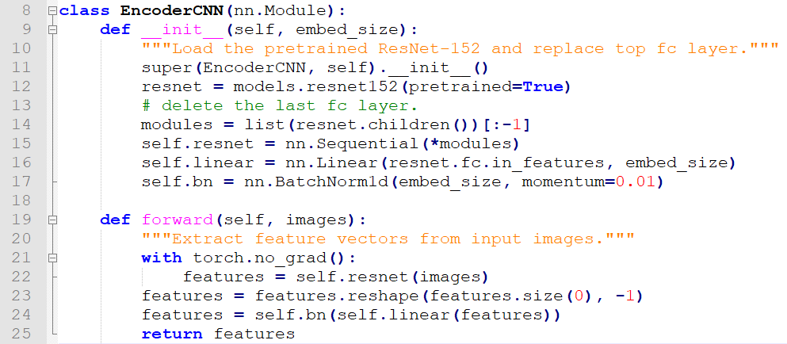
Pretrained ResNet-152
Delete the last fc layer, use NEW linear layer to transform feature vector to have the same dimension as the input dimension of the LSTM network

Slide 15
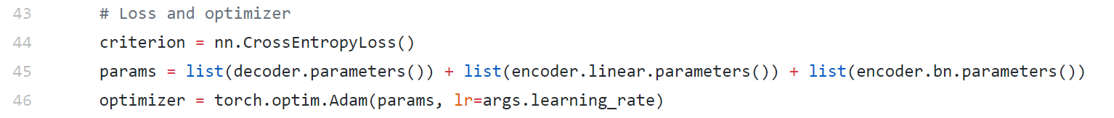
Parameters Update
In train.py Line 45 ~ 46
ResNet part parameters won’t update

Slide 16
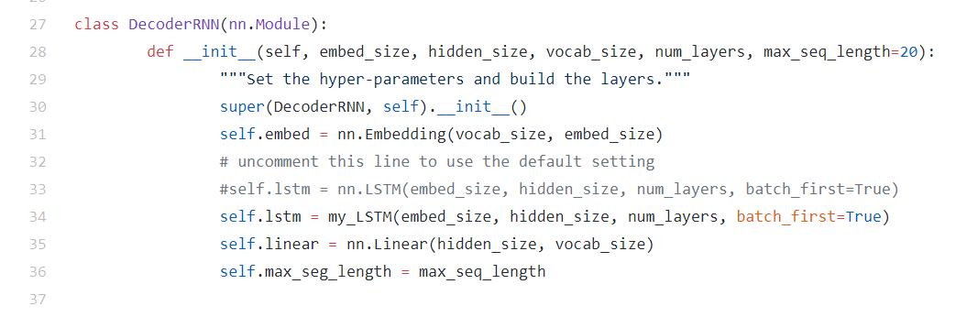
Decoder
Noticed that you will use your model in model.py line 34
You can use nn.LSTM to check your environment is OK or not

Slide 17
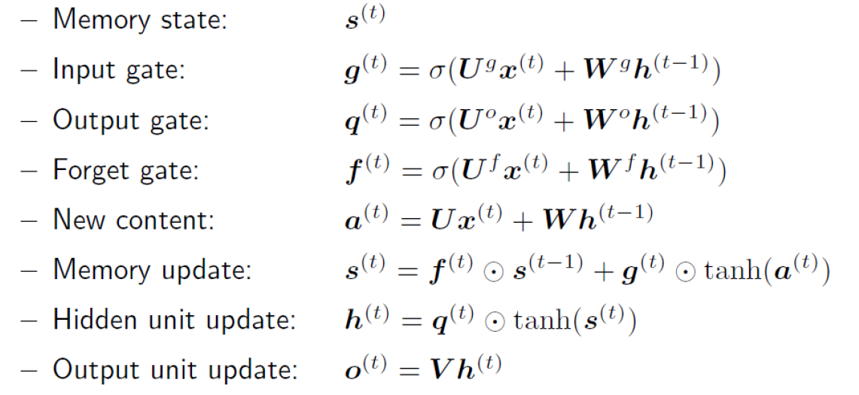
LSTM Recall
At professor slide “RecurrentNeuralNetworks.pdf”

Slide 18

Lstm Implement Hint
You can use nn.Linear to build your lstm
RNN Example

Slide 19
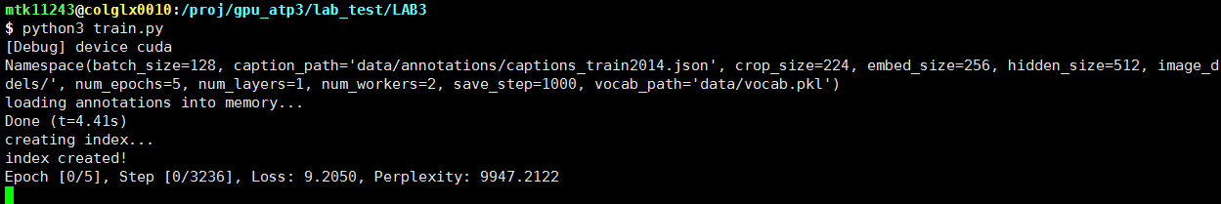
Training

Slide 20
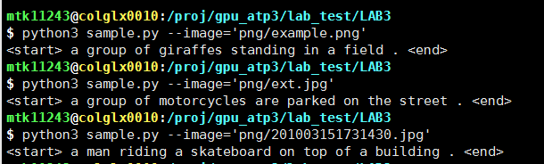
Testing

Slide 21
Report Spec & Demo
Introduction (5%)
Explain how you implement LSTM (45%)
Results – generating corresponding descriptions
A. example.png (10%)
B. ext.png (10%)
Discussion (10%)
Demo
Test your model on a given picture (10%)
Question (10%)

Slide 22
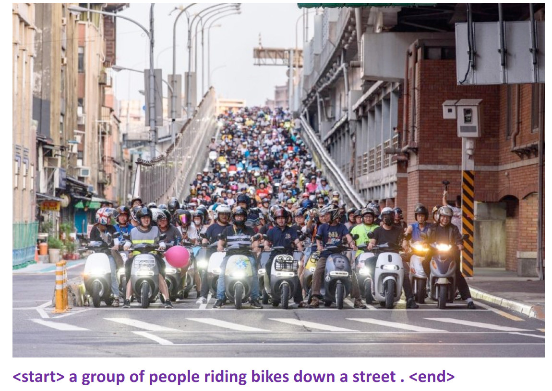
Demo example
Like “Results” in Report
The demo testing will
be uploaded before Demo

